Slide 1
Loan Default Model
Risk assessment using machine learning

Slide 2
Should we take the risk?
A practical question that any lender should ask when deciding to loan money is ‘what is the risk?’.
This is an essential step in the loan process but can be time consuming.
What if there was an easier way to help your financial institution branches make lending decisions quickly?
This is where machine learning takes the spot light!

Slide 3
Time and Resource Management
Allowing a machine learning prediction model to aid.
Reviewing loan applications one by one.
Time consuming
Expensive
Risk assessment open to human interpretation
Ambiguous process and results
Quick and effective
Cost friendly
Risk assessment done using statistical mathematics.
Uniform process and uniform results

Slide 4
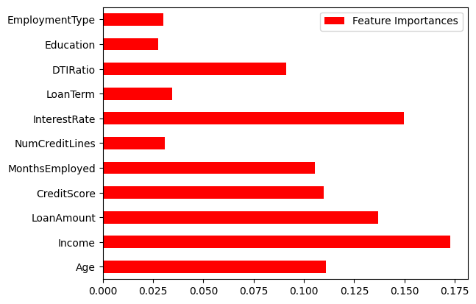
Loan Risk Assessment Model
This is a visualization from the trained machine learning model used to make predictions for risk assessment.
This chart depicts that these features are what the model used as important factors when making predictions.
The income of a borrower holds the most significance as you well know is one of the most important loan deciding factors.

Slide 5
Model Results
The model that has been trained had an accuracy of almost 90%
The model is performing significantly well at predicting when a customer will not be in default.
Accuracy: 88%
F1 metric score of 94% for good standing borrowers

Slide 6
Should I Consider Using this Model?
Critical components for a robust profitability analytics solution include data integration, real-time data flow, machine learning (ML), and a design that maximizes usability. - ‘Shipra Sooden’
There are many research documents that help drive home the necessity of machine learning models for profitability.
This model is no different. The model is designed to streamline the loan risk assessment process by saving time and minimizing risk of default.

Slide 7
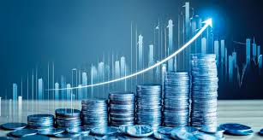
In Conclusion
This machine learning model is a focused self driven analytic tool for your financial institution.
Integrating it into the software of your loan officers for risk assessment will yield profitable results.
Let us move forward into the future of lending together.

Slide 8
Bibliography
Shipra Sooden. “Beyond the spreadsheets: How analytics can unlock hidden profits”. Fractal, https://fractal.ai/harness-analytics-for-maximizing-profit-margins/#:~:text=Artificial%20Intelligence%20and%20Machine%20Learning%20can%20significantly%20enhance%20profitability%20analytics,data%2Ddriven%20profitability%20optimization%20strategies.

